Slide 1
Bitcoin Price Prediction
By Rakesh Choudhary

Slide 2
Agenda
Project Overview
Dataset Overview
Data Preprocessing
Feature Engineering
Data Exploration
Model Deployment
Model Evaluation
Conclusion

Slide 3
Project Overview
This project aims to develop a robust forecasting model to predict Bitcoin prices using SARIMA, Random Forest, and XGBoost models. By combining time series, machine learning, and ensemble methods, the model will enhance forecasting accuracy, capture complex price movements, and provide valuable insights into cryptocurrency market trends.
The goal is to enable data-driven decision-making by helping businesses and traders anticipate price fluctuations, optimize trading strategies, and manage risk more effectively.
With improved price predictions, companies can proactively adjust their investment strategies, mitigate potential losses, and maximize returns in the volatile Bitcoin market.

Slide 4
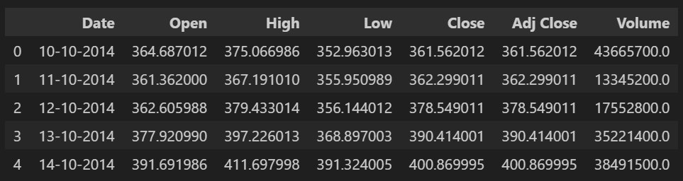
Dataset Overview
The dataset contains 7 columns with detailed bitcoin related information which includes 3566 entries.
There are 6 columns with float data types and 1 column with object data types.
The target feature is ‘Close’ column.
Date: The date of the recorded Bitcoin price data.
Open: The opening price of Bitcoin for that day.
High: The highest price Bitcoin reached during that day.
Low: The lowest price Bitcoin reached during that day.
Close: The closing price of Bitcoin for that day.
Adj Close: The adjusted closing price, which accounts for any corporate actions like stock splits or dividends.
Volume: The total number of Bitcoin units traded during that day.

Slide 5
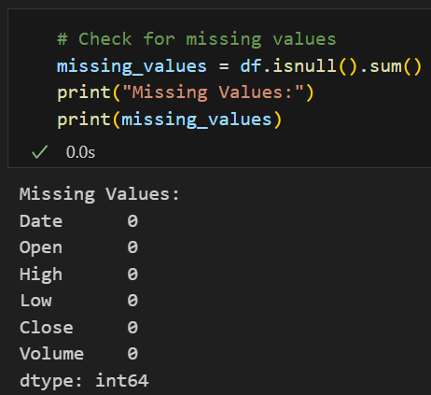
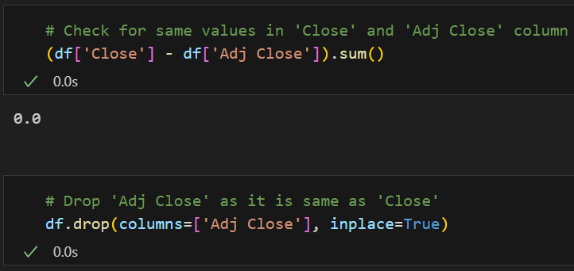
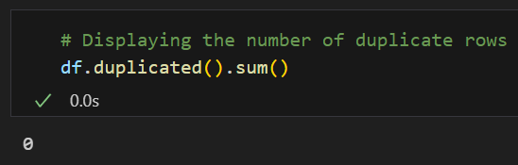
Data Preprocessing
Same Columns: There is a column named ‘Adj Close’ which have same values like in ‘Close’ column in the dataset. So, removing this column is feasible.
Duplicates Values: There is no duplicates values in the dataset.
Missing Values: There is no missing values in the dataset.
After checking missing & duplicates values, the updated dataset size is 3566.

Slide 6
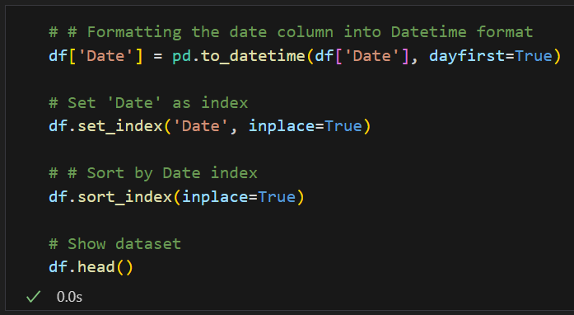
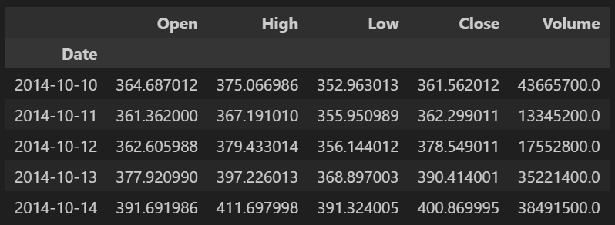
Data Preprocessing
Formatting 'Date' column: Formatting the 'Date' column to properly convert it into datetime objects for accurate time series operations.
Setting 'Date' as index: Setting 'Date' as the index organizes the dataset chronologically for time-based analysis and modeling.
Sorting by ‘Date’ index: Sorting the index ensures the data is in proper time order, which is crucial for accurate forecasting and evaluation.

Slide 7
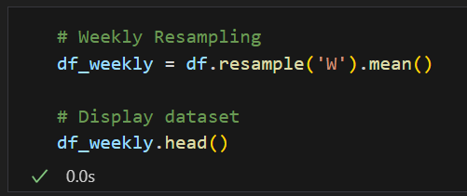
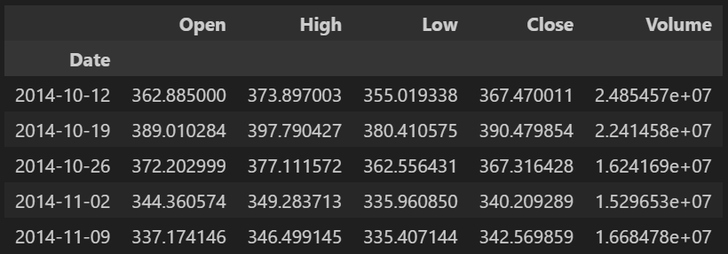
Data Preprocessing
Weekly Resampling: Weekly Resampling aggregates the daily Bitcoin price data into weekly averages, which helps smooth out short-term volatility and random fluctuations.
This makes the time series more stable, easier to analyze, and better suited for building reliable forecasting models.
After doing weekly resampling, the updated dataset size is 510.

Slide 8
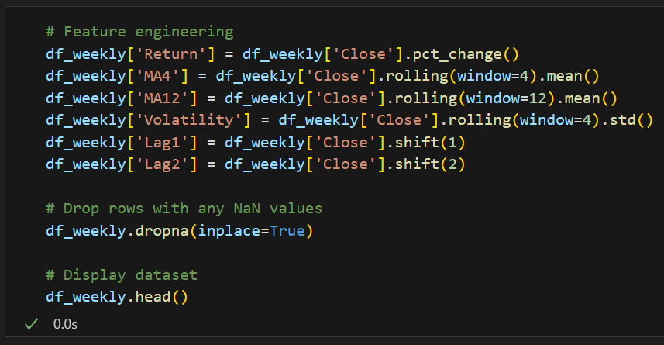
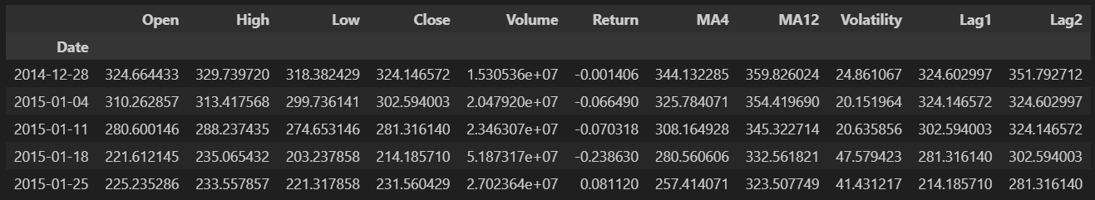
Feature Engineering
In this project, new features were created to capture important patterns in the Bitcoin price movements:
‘Return’: Weekly percentage change in closing price (captures short-term momentum).
‘MA4’ & ‘MA12’: 4-week and 12-week moving averages (identify short-term and medium-term trends).
‘Volatility’: 4-week standard deviation of closing price (reflects market uncertainty and risk).
‘Lag_1’ & ‘Lag_2’: Past closing prices (capture temporal dependencies).
After doing feature engineering, the updated dataset size is 499.

Slide 9
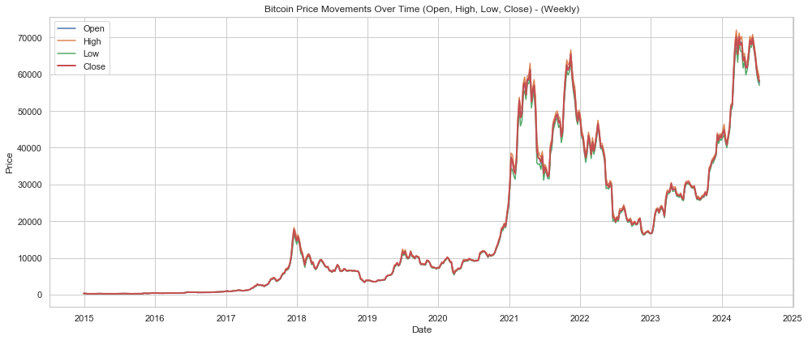
Data Exploration
Bitcoin Price Movements Over Time (Open, High, Low, Close) - (Weekly).

Slide 10
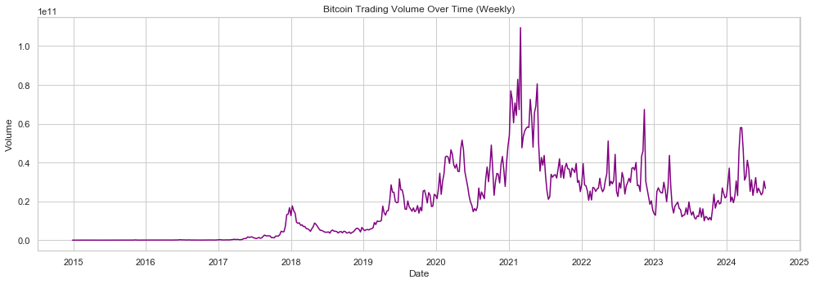
Data Exploration
Bitcoin Trading Volume Over Time (Weekly).

Slide 11
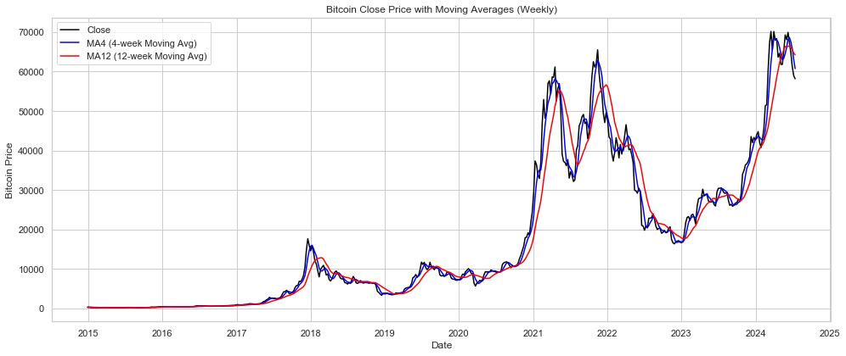
Data Exploration
Bitcoin Close Price with Moving Averages (Weekly).

Slide 12
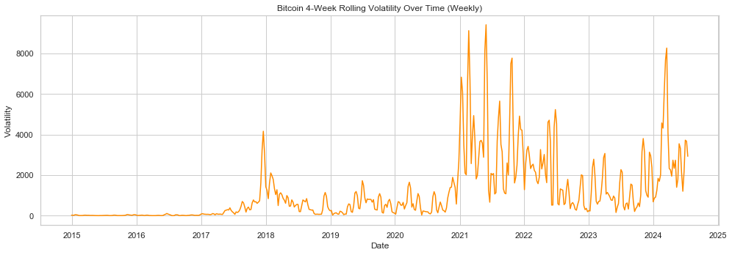
Data Exploration
Bitcoin 4-Week Rolling Volatility Over Time (Weekly).

Slide 13
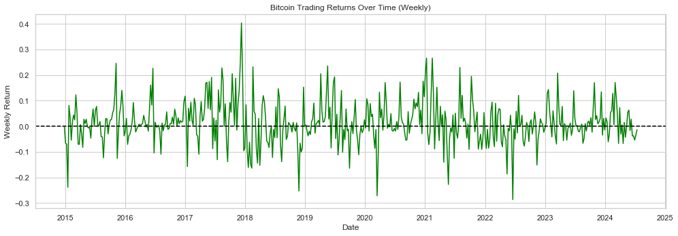
Data Exploration
Bitcoin Trading Returns Over Time (Weekly).

Slide 14
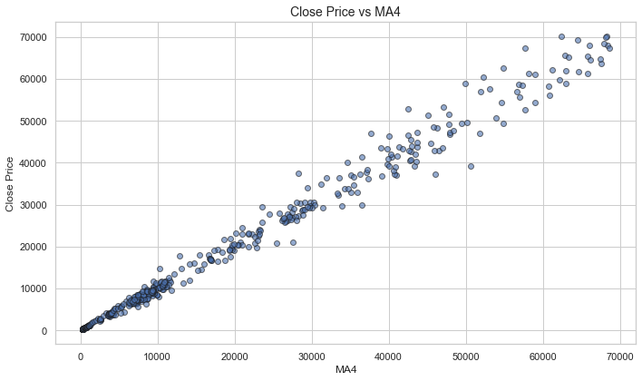
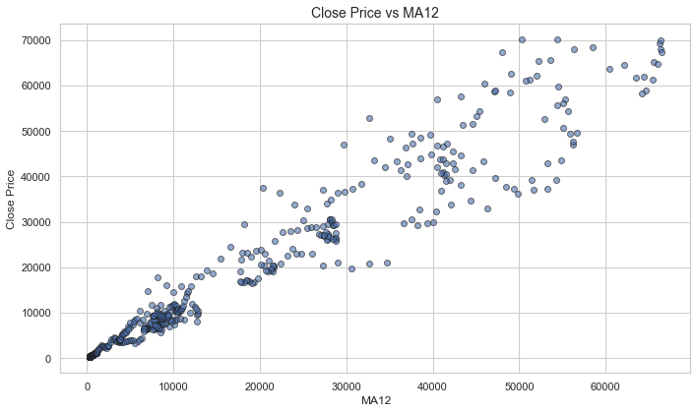
Data Exploration
Scatter Plots of Close Price vs MA4 and MA12.

Slide 15
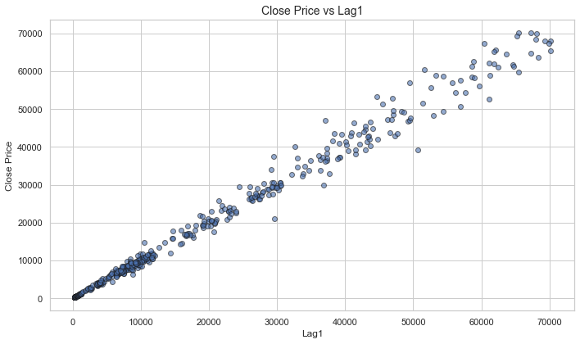
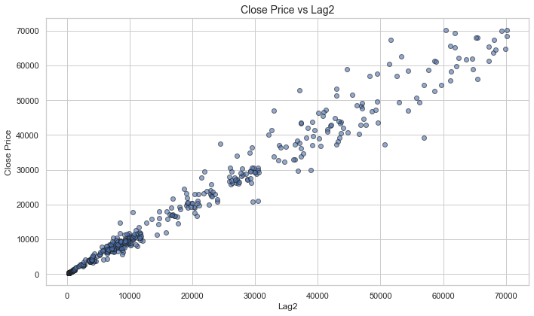
Data Exploration
Scatter Plots of Close Price vs Lag1 and Lag2.

Slide 16
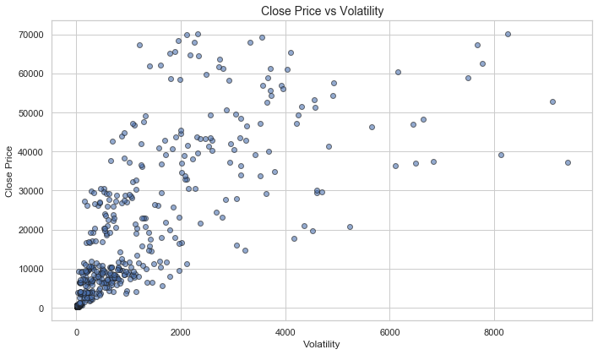
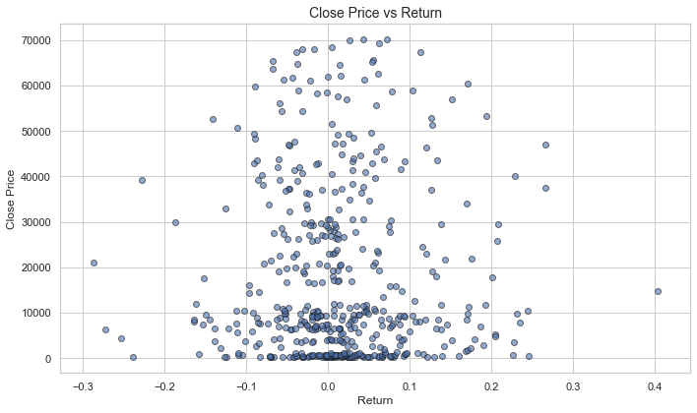
Data Exploration
Scatter Plots of Close Price vs Volatility and Return.

Slide 17
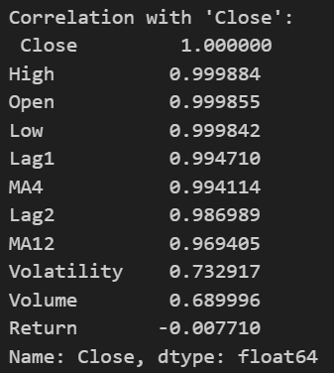
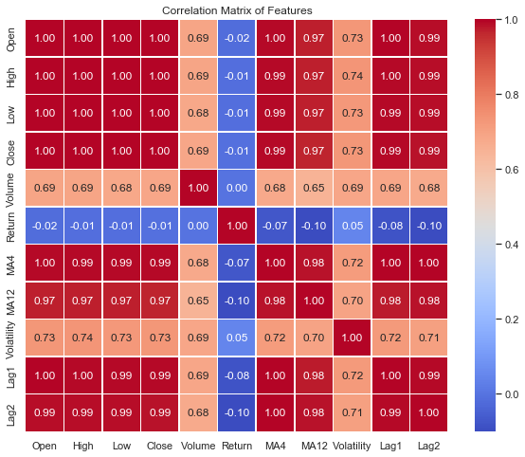
Data Exploration
The Correlation Matrix is used to get correlation between all features and ‘Close’ column.
‘High’, ‘Open’, ‘Low’, ‘Lag_1’, ‘MA4’, ‘Lag_2’, ‘MA12’ have high correlation with ‘Close’ column.
‘Volatility’, ‘Volume’ have moderate correlation with ‘Close’ column.
‘Return’ has negligible correlation with ‘Close’ column.

Slide 18
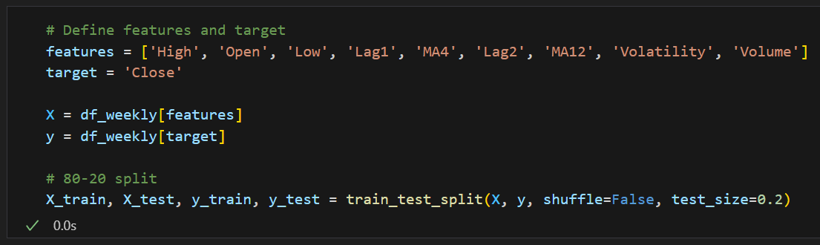
Model Deployment
In the Data Splitting step, we divided the dataset into two parts: X and y.
X contains all the independent variables, which are the features used to make predictions.
Meanwhile, y represents the dependent variable or target variable, which is the outcome we want to predict.
In the Train-Test Splitting Step, the dataset was split into training and testing sets.
An 80:20 ratio was used, with 80% of the data allocated to training and 20% to testing, and the test size set to 0.2 and the shuffle parameter set to false to prevent shuffling of the data.

Slide 19
Model Deployment
In the Model Selection step, we have to select models for forecasting of ‘Close’ metric to evaluate Bitcoin Price Prediction Performance.
Since this is a time series regression problem, appropriate models were selected to capture trends, seasonality, and complex patterns in the data.
SARIMA (Seasonal AutoRegressive Integrated Moving Average):
An extension of ARIMA designed to model both non-seasonal and seasonal patterns in time series data.
Advantages: Captures trends, seasonality, and autocorrelations; suitable for data with regular seasonal cycles.
Limitation: Needs careful parameter tuning; assumes linear patterns and can struggle with highly irregular data.
Random Forest Regressor:
Handles non-linear relationships by leveraging ensemble learning.
Advantages: Robust to noise, captures complex patterns, and performs well on large datasets.
Limitation: Higher computational cost and less interpretability compared to traditional time series models.

Slide 20
Model Deployment
To improve the accuracy of the model, Gradient Boosting Model was used for forecasting ‘Close’ metric by capturing complex patterns in the data.
XGBoost Regressor (Extreme Gradient Boosting for Regression):
A powerful gradient boosting model designed for regression tasks on structured data.
Advantages: Handles complex non-linear relationships, prevents overfitting through regularization, and offers high prediction accuracy.
Limitation: Computationally demanding and sensitive to hyperparameter choices.
A hybrid approach combining two models (Random Forest Regressor & XGBoost Regressor) was used to leverage their strengths and improve forecasting accuracy.

Slide 21
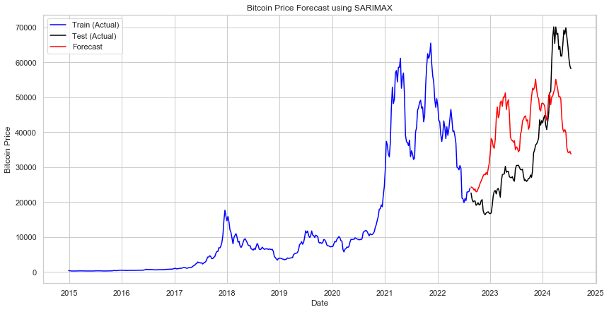
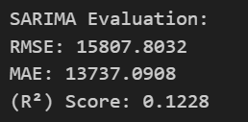
Model Evaluation
SARIMA Model Evaluation
The evaluation of SARIMA model is shown below.
Achieved an R² score of 0.1228, indicating weak explanatory power for the variance in Bitcoin prices.
RMSE: 15,807.80 and MAE: 13,737.09, suggesting significant average prediction errors.
The SARIMA model is not well performed.

Slide 22
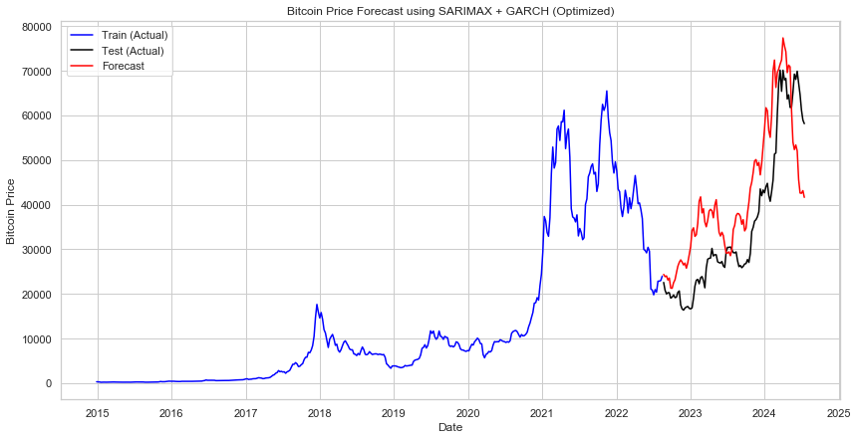
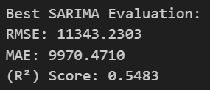
Model Evaluation
Hyperparameter Tuned SARIMA Model Evaluation
The evaluation of SARIMA model is shown below.
Achieved an improved R² score of 0.5483, indicating moderate ability to explain the variance in Bitcoin prices.
RMSE: 11,343.23 and MAE: 9,970.47, reflecting reduced average prediction errors compared to the initial SARIMA model.
The SARIMA model is not well performed even after hyperparameter tuning.

Slide 23
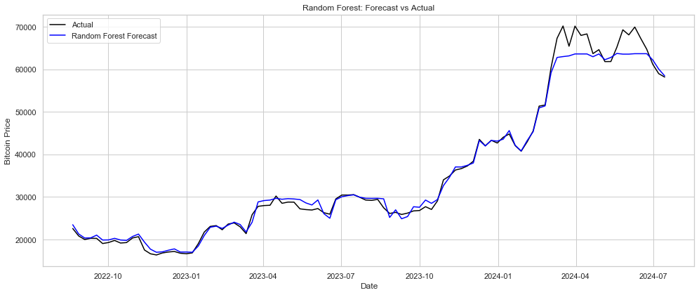
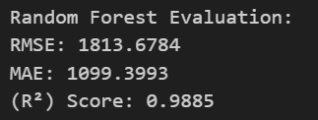
Model Evaluation
Random Forest Regressor Model Evaluation
The evaluation of RF model is shown below.
Achieved a high R² score of 0.9885, demonstrating excellent ability to explain the variance in Bitcoin prices.
RMSE: 1,813.68 and MAE: 1,099.40, indicating low average prediction errors and strong overall performance.
The RF model is not well performed.

Slide 24
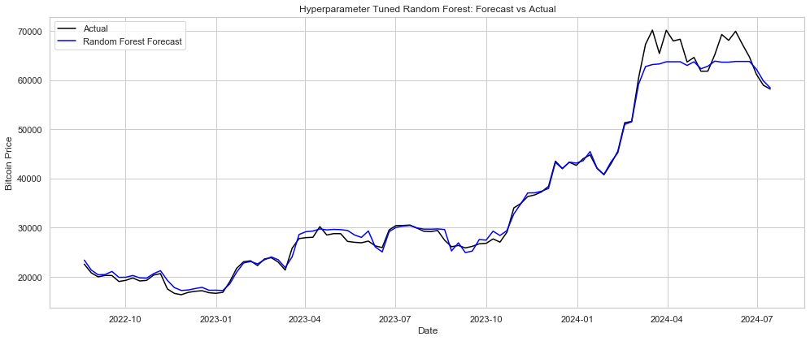
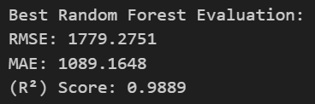
Model Evaluation
Hyperparameter Tuned Random Forest Regressor Model Evaluation
The evaluation of RF model is shown below.
Achieved an improved R² score of 0.9889, showing excellent predictive performance with even better variance explanation.
RMSE: 1,779.28 and MAE: 1,089.16, reflecting slightly lower prediction errors after tuning.
The RF model is performed good after hyperparameter tuning.

Slide 25
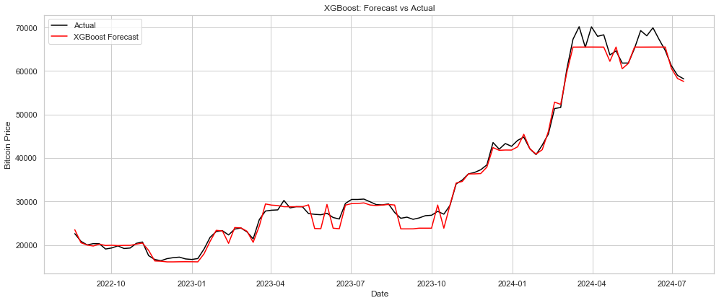
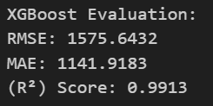
Model Evaluation
XGBoost Regressor Model Evaluation
The evaluation of XGBoost model is shown below.
Achieved an R² score of 0.9913, indicating outstanding ability to capture variance in Bitcoin prices.
RMSE: 1,575.64 and MAE: 1,141.92, demonstrating very low average prediction errors and strong model accuracy.
The XGBoost model is well performed.

Slide 26
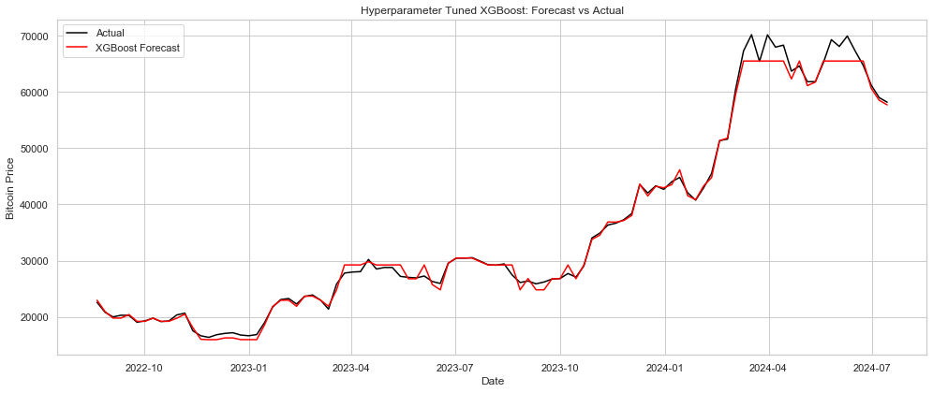
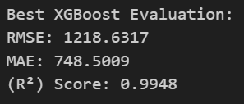
Model Evaluation
Hyperparameter Tuned XGBoost Regressor Model Evaluation
The evaluation of XGBoost model is shown below.
Achieved an improved R² score of 0.9948, showcasing exceptional predictive power and perfect variance explanation.
RMSE: 1,218.63 and MAE: 748.50, indicating significantly reduced prediction errors after tuning.
The XGBoost model is performed good after hyperparameter tuning.

Slide 27
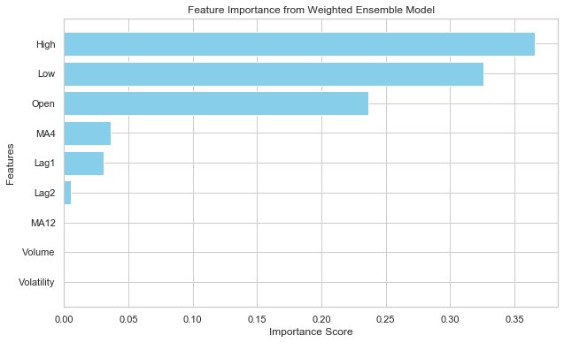
Model Evaluation
The Visualization of Feature Importance from Weighted Ensemble Model shows which features have more importance in the model.
The ‘High’ feature has the highest importance, followed by ‘Low’ and ‘Open’, indicating that daily price levels are the most significant factors in predicting Bitcoin's weekly closing price.
‘MA4’ and ‘Lag_1’ show moderate importance, suggesting that short-term trends and immediate past prices contribute to the model’s forecasting ability.
‘Lag_2’ has minimal impact, while ‘MA12’, ‘Volume’, and ‘Volatility’ show negligible importance compared to the top predictors in the Weighted Ensemble model.

Slide 28
Conclusion
Key Feature Insights:
‘High’, ‘Low’, and ‘Open’ prices are the top predictors, indicating the weekly price range is crucial for forecasting.
‘MA4’ and ‘Lag_1’ have moderate importance, reflecting short-term trends and recent price movements.
‘Lag_2’, ‘MA12’, ‘Volume’, and ‘Volatility’ have minimal impact, suggesting long-term averages and market uncertainty are less influential.
Immediate market activity has more influence on predicting weekly Bitcoin closing prices than historical trends or volatility.
Model Performance:
XGBoost (tuned) showed the best predictive power, demonstrating excellent performance in forecasting.
Random Forest (tuned) effectively captured complex, non-linear patterns, contributing strong results.
SARIMA struggled with Bitcoin's volatility and non-linear behavior, resulting in weak performance.
A weighted ensemble of XGBoost and Random Forest combined predictions to improve accuracy and robustness.
Combining model insights and feature importance enhanced forecasting and understanding of Bitcoin price drivers.

Slide 29
Conclusion
Business Suggestions:
Focus on Key Price Drivers: Prioritize tracking ‘High’, ‘Low’, and ‘Open’ prices, as they significantly impact Bitcoin price predictions.
Leverage Short-Term Trends: Utilize ‘MA4’ and ‘Lag_1’ to capture short-term trends and adjust trading strategies based on recent market movements.
Minimize Volatility Risk: Since ‘Volatility’ and ‘Lag_2’ have minimal influence, avoid relying too much on long-term trends or volatility for predictions.
Enhance Real-Time Strategy: Integrate real-time data based on ‘MA4’ and ‘Lag_1’ to quickly adjust trading decisions during volatile market conditions.
Refine Feature Selection: Streamline the model by focusing on high-impact features like ‘High’, ‘Low’, and ‘Open’, reducing noise from less influential data points.
Optimize Risk Management: Use ‘High’, ‘Low’, and ‘Open’ to create dynamic stop-loss strategies, protecting investments against sudden market shifts.
Monitor Seasonal Trends: Leverage key price drivers to identify and act on seasonal trends for better timing of market entry and exit.

Slide 30
Thank You

